Slide 1
Research Methodology in Computing & Engineering CT095-6-M-RMCE
Evaluating LLMs on Equivalence Checking of
Digital Design Specifications with
Register Transfer Level Designs
WONG CHENG YEE
Assignment Title | Evaluating LLMs on Equivalence Checking of Digital Design Specifications with Register Transfer Level Designs
Student Name | WONG CHENG YEE
Intake Code | APUMP2310
TP No | TP068639
Lecturer Name | Assoc. Prof. Dr. Raja Rajeswari
Project Supervisor Name | Dr. Kuan Yik Junn
Second Marker Name | Ms. Hairul Aysa Binti Abdul Halim Sithiq

Slide 2
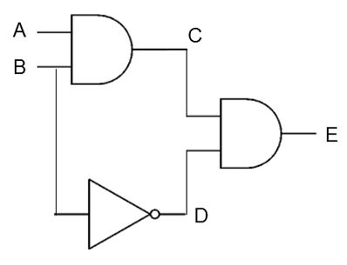
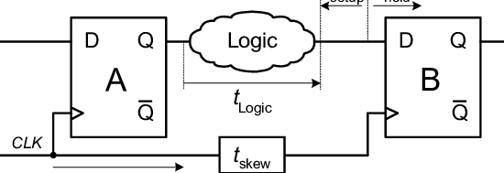
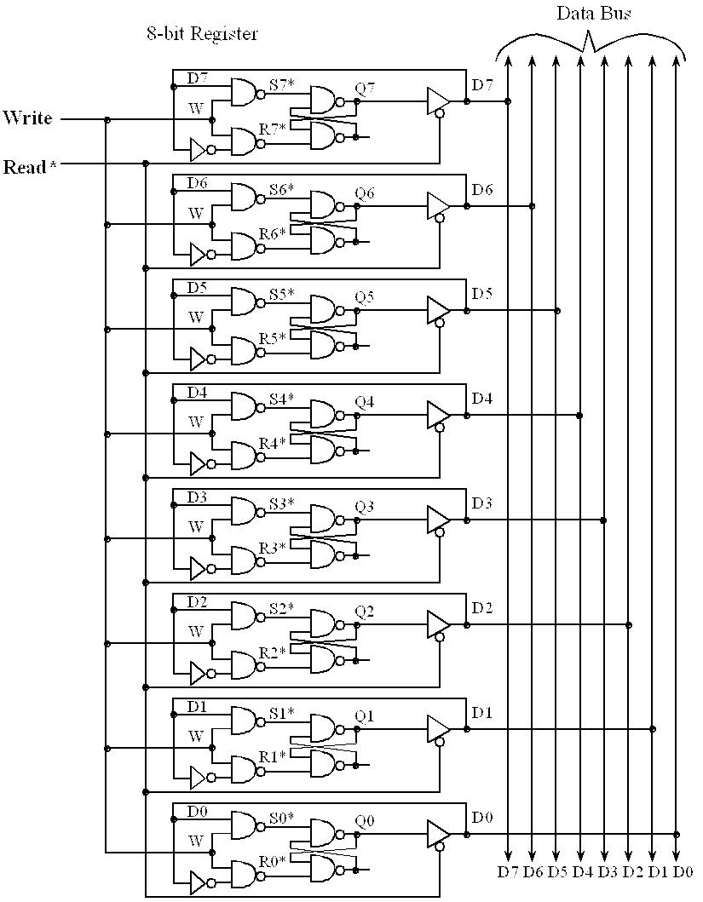
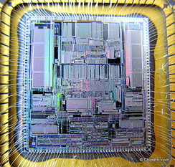
Introduction
Integrated Circuit consists of
Digital Circuits
Logic Gates (AND, OR, NOT, etc)
Flip Flops
Memory
etc
etc
Logic Gates
Flip Flops
Integrated Circuit
Memory

Slide 3
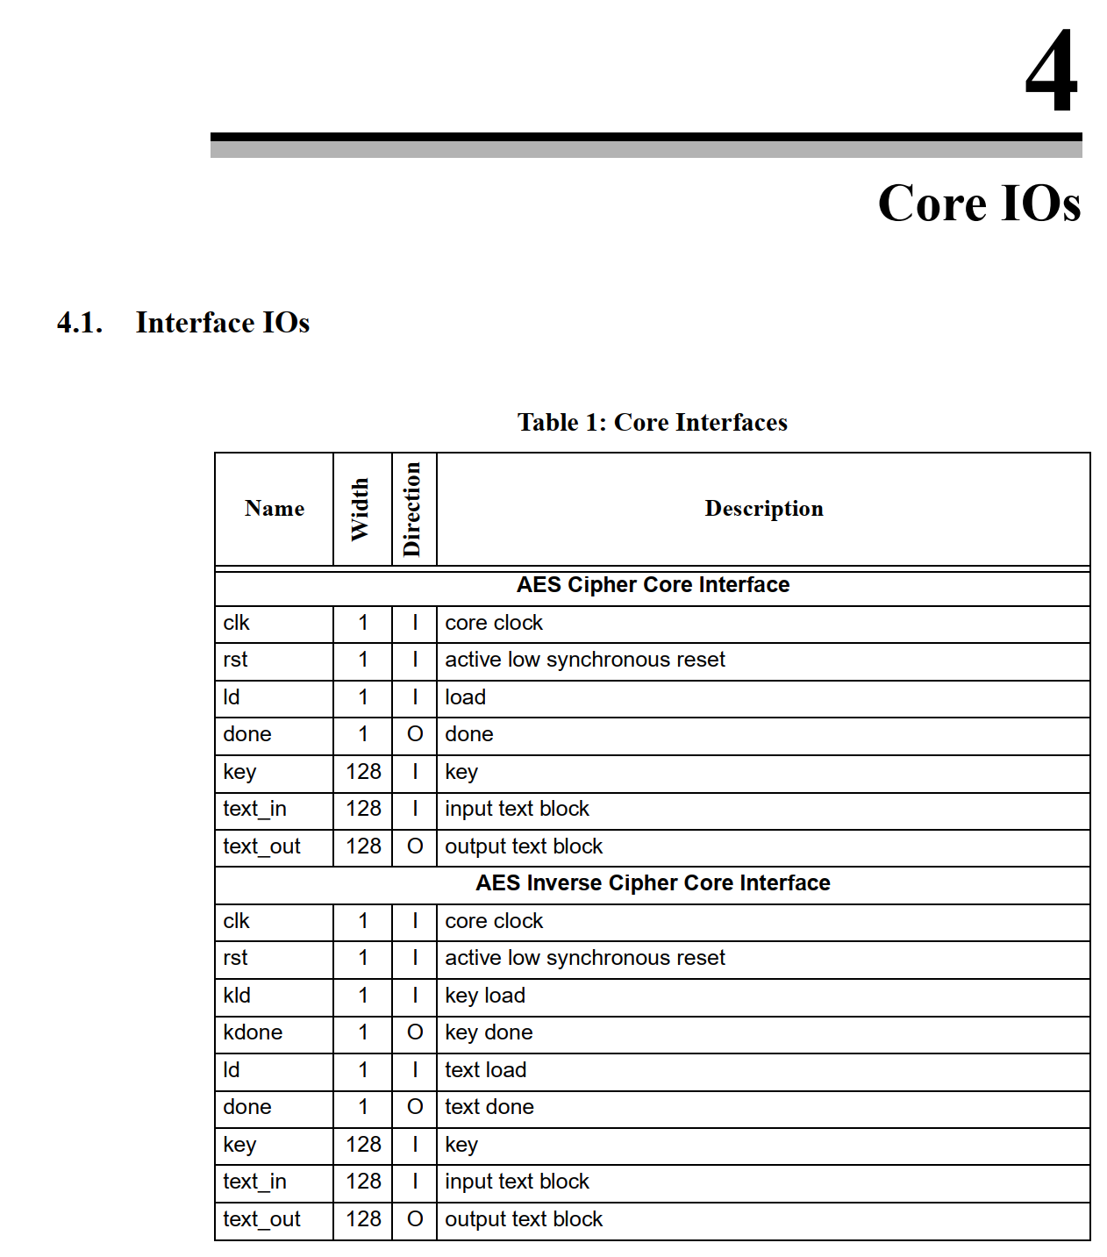
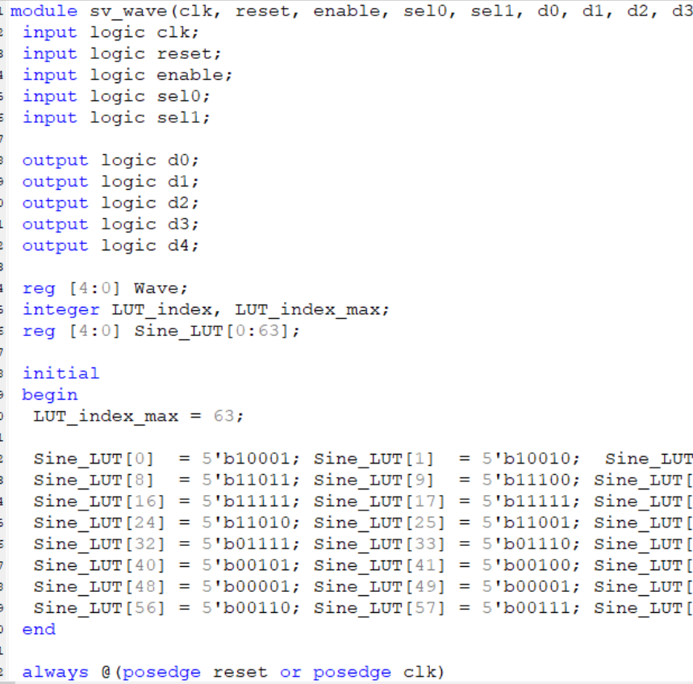
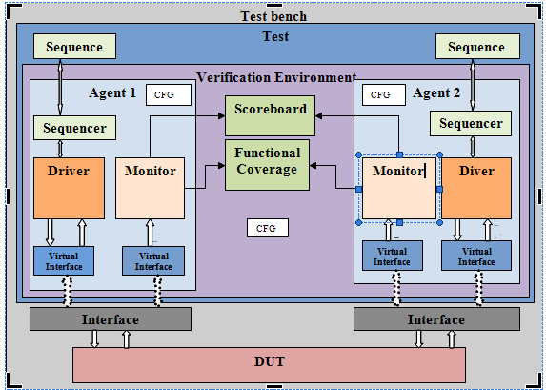
Introduction
Digital Logic Designs Flow | Owner | Output
High-level Digital Design Architecture | Architects | Digital Design Specifications
Register Transfer Level (RTL) Design | Designers | SystemVerilog RTL Designs
Digital Verification | Validator | SystemVerilog UVM Test Bench (TB)
Specifications
RTL
TB

Slide 4
Problem Statement
Specifications
RTL
TB
Redundant
Misalignment of Specifications and RTL.
Lead to RTL that is
Irrelevant
Unused
Invalid

Slide 5
Problem Statement
Miscommunications among the architects, designers and validators.
Architect is busy and unable to do RTL designs review precisely and in details.
Lead to redundant/irrelevant/unused/invalid RTL code.
Validators, who typically communicate with the designers.
face challenges verifying the digital design to ensure better coverage.
Designers lack of the correct/accurate mindset regarding the digital design specifications, which may lead to the transmission of incorrect messages to the validators.
This issues can be undetectable by test bench.

Slide 6
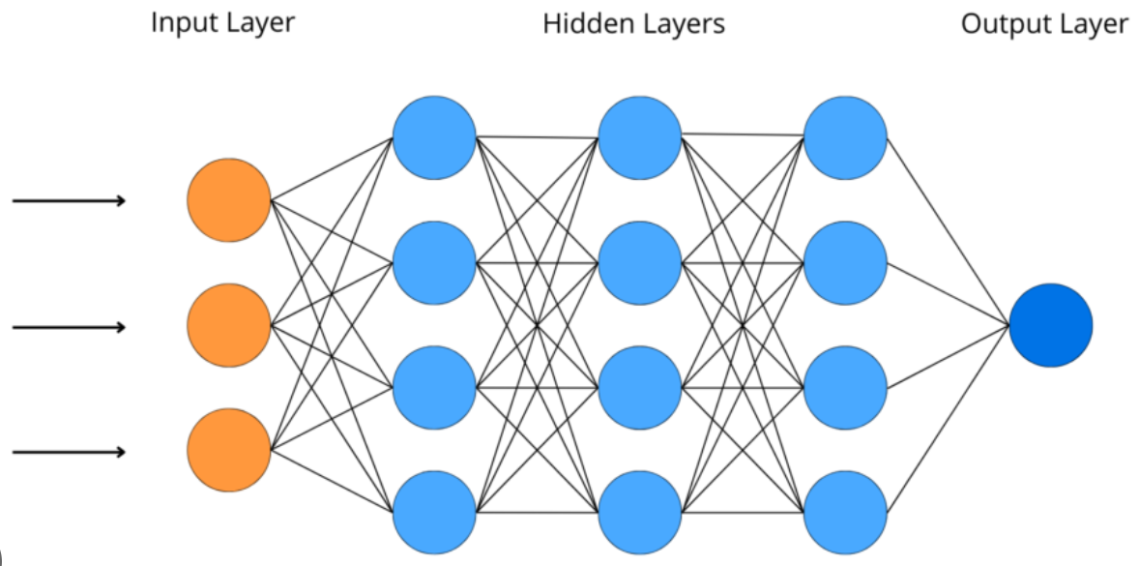
The role of LLMs
Deep Neural Network model designed with transformers to understand/generate/translate human languages.
Predict probability of sequence of words occurring in a given language.
Pre-trained with billions number of parameters.
LLMs like GPT-4 is used for this project
Capabilities to recognize/analyze/understand languages that allows features extractions from specifications and RTL.

Slide 7
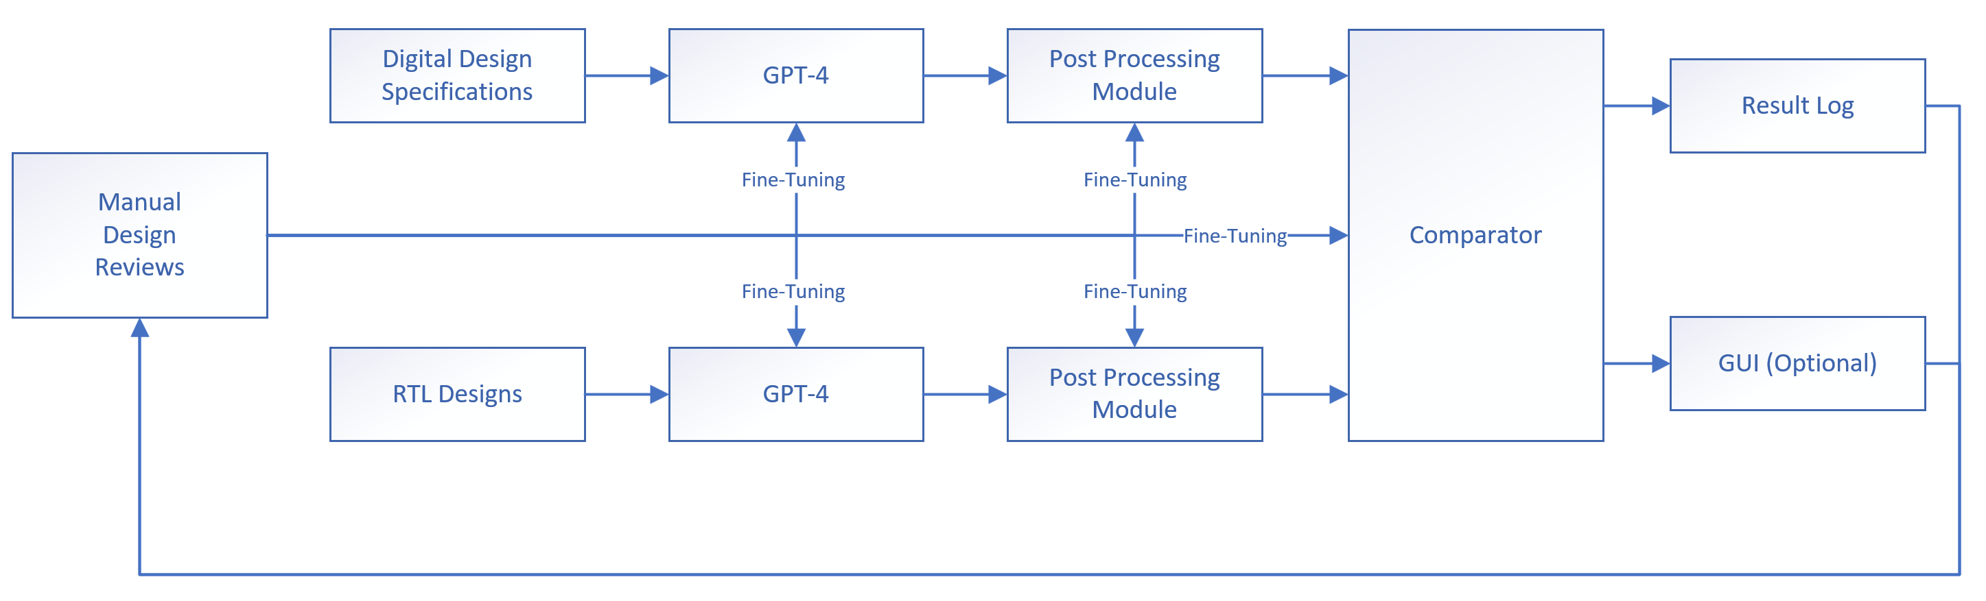
Equivalence Checker

Slide 8
Block Level Descriptions
Block | Descriptions
Digital Design Specifications | Documented in word file. Define the architecture and functionality of a digital system. Source from OpenCores.
RTL Designs | Zipped of bundle of SystemVerilog RTL code. Source from OpenCores.
GPT-4 | Digital design features extraction.
Post-Processing Module (PPM) | Post processing module for features extraction from GPT-4.
Comparator | Compares the features extracted from PPM for Digital Design Specifications and RTL Designs.
Result Log | Detailed list of inaccuracies or discrepancies between the Digital Design Specifications and RTL designs.
GUI | Displays the results of the comparison to the user.
Manual Design Reviews | By architects, designers and validators. Critical feedback loop to improve and fine-tuning GPT-4, PPM and comparator.

Slide 9
Implementation/Integration
Block | Descriptions
Digital Design Specifications | Exploring the need for parsing, preprocessing, sequencer or it can be optional?
RTL Designs | Exploring the need for parsing, preprocessing, sequencer or it can be optional?
GPT-4 | GPT-4 API will be used to access the GPT-4 model. Features extraction and answer user queries.
Post-Processing Module (PPM) | Python libraries like pandas and scikit-learn. Feature Identification, Feature representation, Data Cleaning and Standardization, Feature Aggregation and Association.
Comparator | Python libraries like difflib and fuzzywuzzy. Feature Comparison, Discrepancy Detection and Result Log Generation.
Result Log | List of identified discrepancies. Locations where discrepancies occur. Timestamps, User information and link to relevant resources for further debugging.
GUI | Python libraries like Tkinter. Display results, filter and search

Slide 10
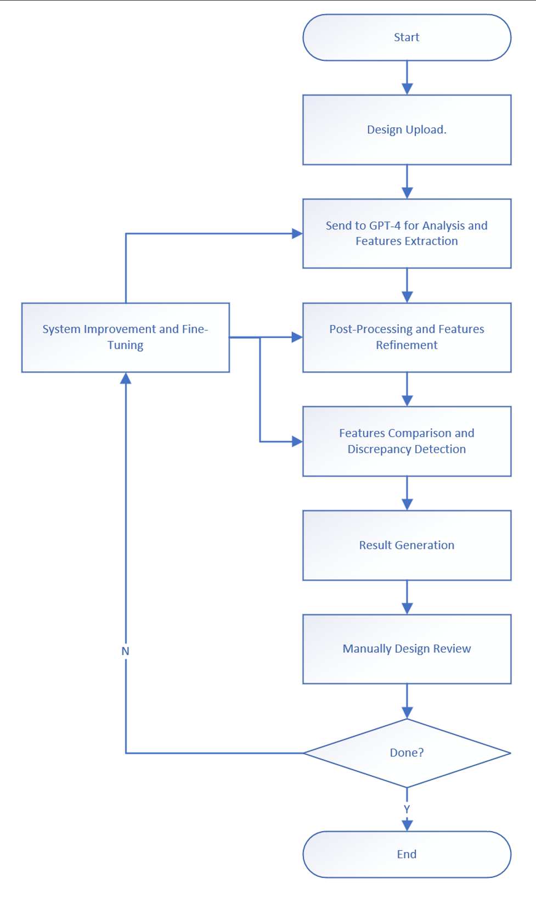
Operational/Validation Flow

Slide 11
Significance
Improving Accuracy and Efficiency
Reducing Miscommunication
Cost-Effectiveness
Contribution to Knowledge Base
Audience and Beneficiaries

Slide 12
Methodology Evaluation
Experiment other LLMs like Google Gemini.
Better/accurate machine learning algorithm for PPM and comparator.

Slide 13
Challenges and Solutions
Optimizing the accuracy and robustness of GPT-4, PPM and comparator.
It required to be done though repeatedly manual design reviews.

Slide 14
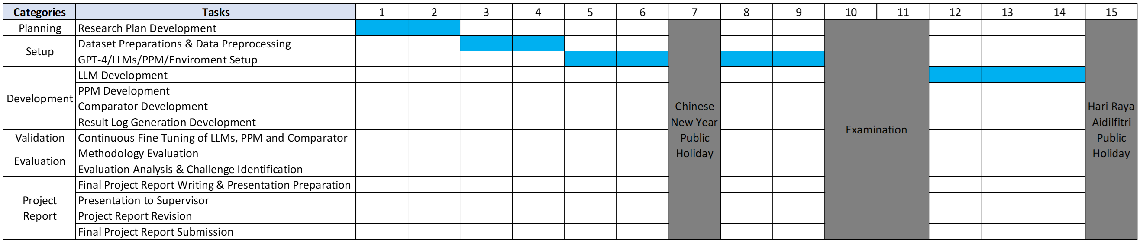
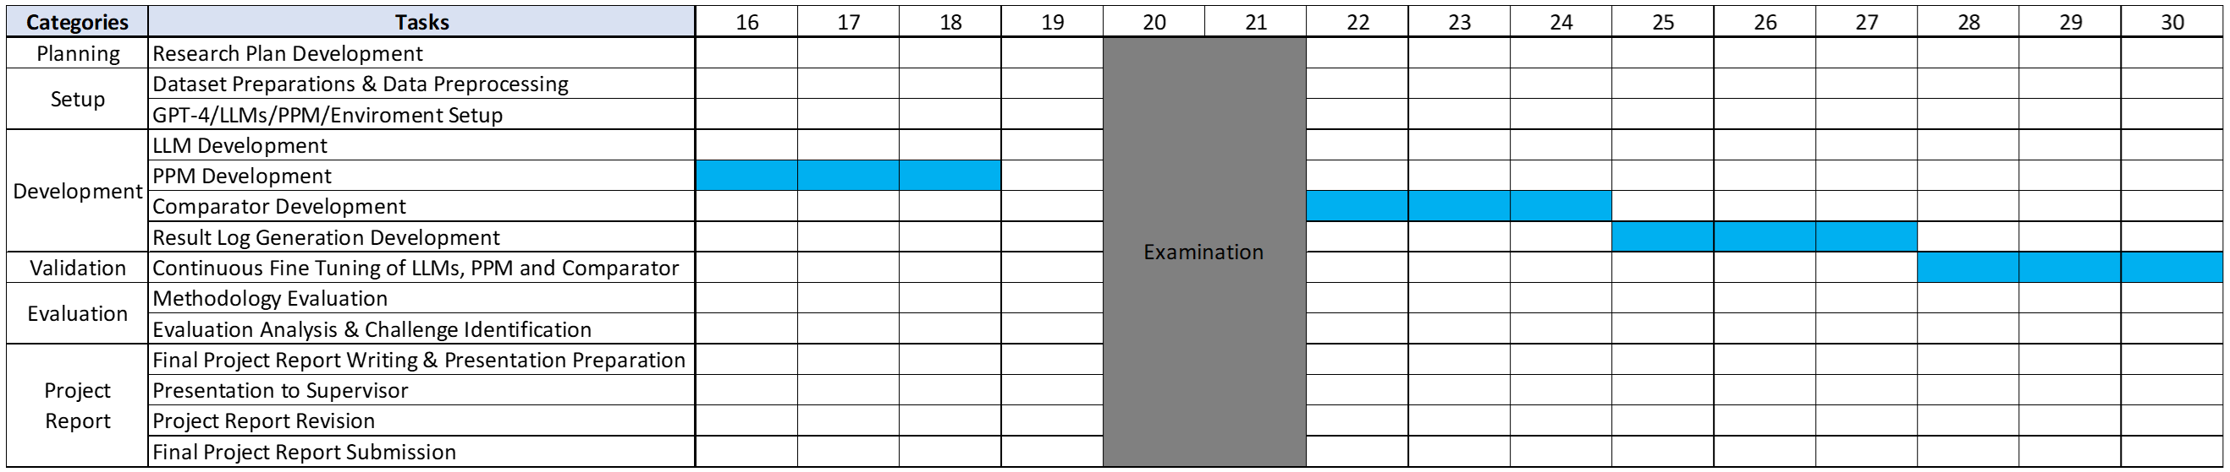
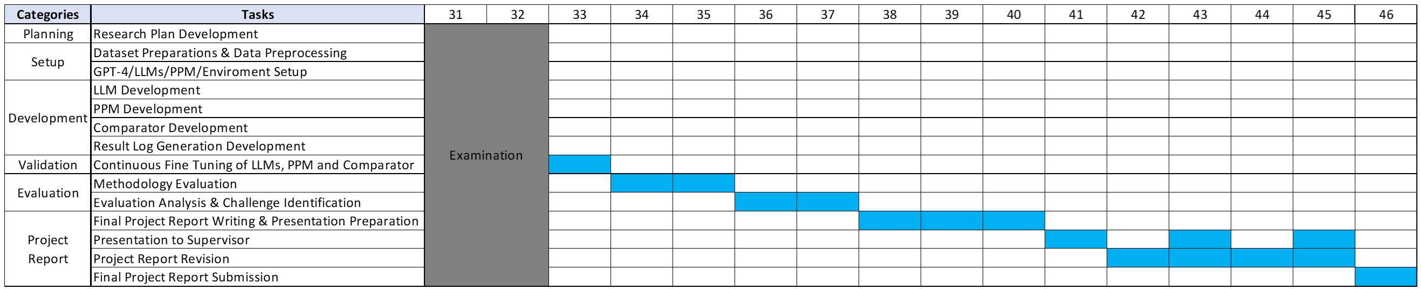
Research Plan

Slide 15
Future Scope
There is 3 tiers of the level of understanding of specifications/RTL. Depending on how in depth GPT-4 can perform equivalence checker. Achieving advance level would be the best case.
LLM on in depth understanding on test plan and potentially constructing test bench to simulate RTL designs.
LLM on in depth understanding on RTL and potentially used for RTL validation like linting, clock domain crossing etc.
etc.

Slide 16
Conclusion
Utilizing LLMs, particularly GPT-4, for equivalence checking in digital design workflows presents a transformative opportunity to ensure higher quality and more efficient design processes, ultimately revolutionizing the verification of digital designs.

Slide 17
Thank You Q&A

